Slide 1
VC Seminar Project
Image-Compression using Lapped Transform
Umair Khalid - 66512
Muhammad Waleed Khan - 64684

Slide 2
Introduction
Goal: The goal of this project could be to evaluate and the effectiveness of different image compression technique –The discrete cosine transform and lapped transform on both color and grayscale images.
Principal measure
Compression Ratio: Ratio of original data size to compressed data size. Higher ratio mean better compression
LPIPS: compares image similarity using deep feature differences, rather than pixel level differnce. It crucial for accessing the perceptual quality of compressed images.

Slide 3
Discrete Cosine Transform (DCT)
DCT Characteristics
Converts spatial domain (pixels) to frequency domain
Concentrates essential information in lower frequencies components
Compresses data by quantizing coefficients and discarding less important details
DCT Code explanation
The function loads images from specific directory as grayscale image using cv2.IMREAD_GRAYSCALE. Then converted to floating point using np.float32
Clipping and Saving: Ensures pixel values are in 0-255 range, converts to uint8, and saves.

Slide 4
Discrete Cosine Transform (DCT)
Color images with DCT | Grayscales images with DCT

Slide 5
Lapped Transform
Aim to address and reduce block artifacts.
Smooth transition between neighboring blocks that share some of these same pixel data which help us blend the edges between them
Convert pixel data to frequency components, focusing on key visual details in lower frequencies for efficient compressions
Image loading, padding, block processing, clipping, saving

Slide 6
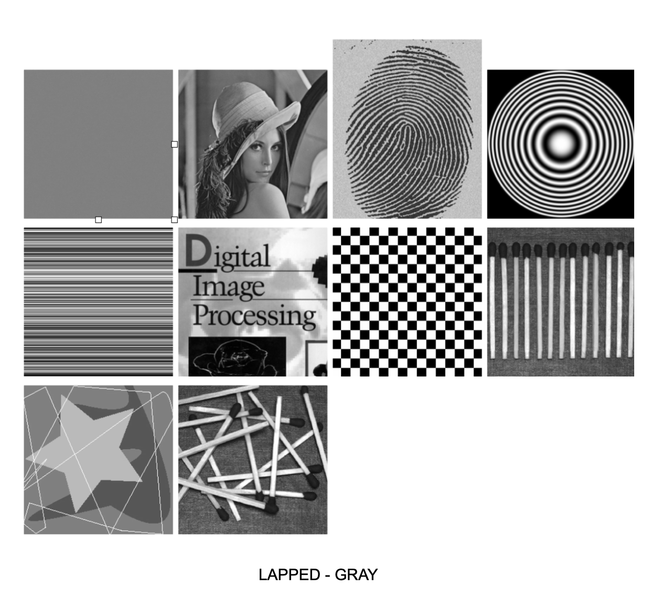
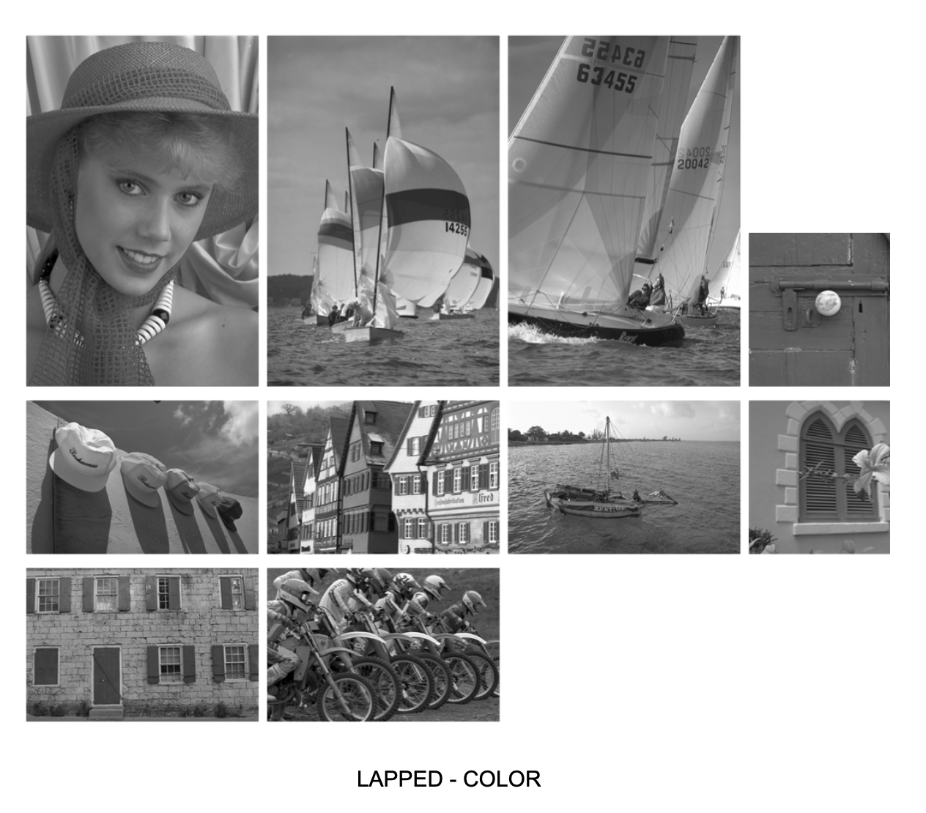
Lapped Transform
Grayscale images with Lapped transform | Color images with lapped transform

Slide 7
Compression Ratio
Ratio between size of original, uncompressed image and size of compressed image
Compression ratio = (original size)/(compressed size)
Higher compresssion ratio and quality trade off
Data Collection: Append result for each image to list
Output: Save results to CSV file for further analysis

Slide 8
Compression Ratio
Color image compression ratio | Grayscale image compression ratio

Slide 9
Learned Perceptual Image Patch Similarity
LPIPS is metric designed to evaluate the perceptual similarity between two images
It uses deep learning model trained on large datasets to assess visual similarity by comparing high level feature instead of raw pixels
It compare compressed images with originals to evaluate how well the compression preserve perceptual quality
For each image a directory containing the file name and ist lpips score is appended to data list

Slide 10
Learned Perceptual Image Patch Similarity
LPIPS for color images | LPIPS for grayscale images

Slide 11
Conclusion
Lapped transform outperformed DCT in both color and grayscale image regarding both compression ratio and perceptual quality
Lapped transform is more effective for maintaining image quality while achieving higher compression

